Slide 1
EBN111
Electricity and Electronics

Slide 2

EBN111
Why electronics and electricity?
Understand new concepts and theories
Understand implications of theory
Think critical about the problem
Apply theory to a new problem
Solve the problem!
Enjoy the challenge to solve new problems.
Notes:
Voorbeeld van afgebakende areas met geen verband met mekaar nie.
Voorbeeld van dubbel en trippel integrale.
Voorbeeld van DV’s.
Dotprodukte en Skalaarprodukte.
Waar gaan jy EBN gebruik? Ek weet nie. Baie slimmer mense as ek het besluit jy moet dit doen sodat jy ‘n graad kan kry wat internasionaal erken kan word.

Slide 3

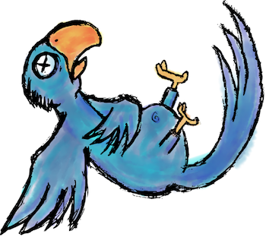
Aim of course
Develop skills to solve electronic circuits
Solve new problems,
in a creative manner,
based on theory.
There are no recipes!
The emphasis is on understanding and not on memorising.

Slide 4
Approach
“For the sole true end of education is simply this: to teach men and women how to learn for themselves; and whatever instruction fails to do this is effort spent in vain.”
– Dorothy Sayers
Notes:
Answer why and not how.

Slide 5
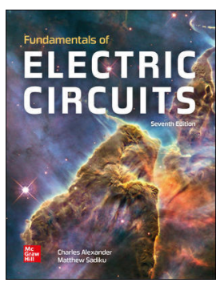

Textbook
Fundamentals of Electric Circuits
Seventh Edition
Charles K. Alexander and Matthew N. O. Sadiku
McGraw Hill International Edition
Copyright: 2021
Famous quote:
“Read the damn textbook!” - Anon

Slide 6

Learning Activities
3 Lectures per week
Read work before (~5min) & after (~15min) lecture
Schedule time to study what you don’t understand.
Go for consultations if you can’t resolve problems.
1 Tutorial class per week
Assignments for each chapter
± 5 hours study time per week excluding lectures!

Slide 7
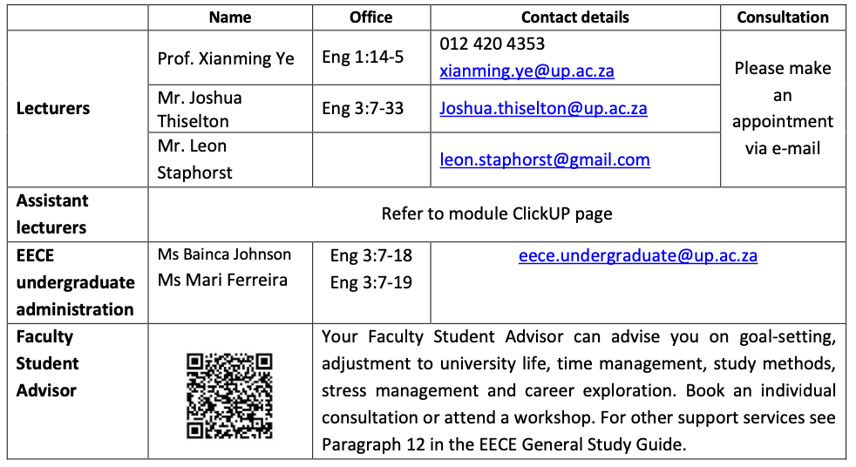
Lecturing team and support

Slide 8

Consultations
Consultation arrangements on ClickUP.
There are specific timeslots each day.
See ClickUP for venues for in-person consultations

Slide 9
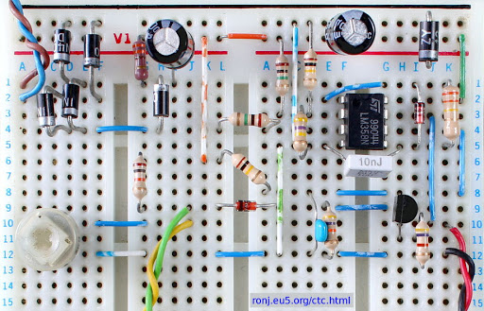
Practicals
Three practicals in the semester
Pre-prac lecture before every practical
Each practical session is 3 hours
You will only have 3 practical sessions in semester
Laboratory
CAEC lab: Eng 2:4-39

Slide 10

Assessment
Semester mark:
Semester tests (x2): 70%
Class tests (x2): 12%
Practicals (x3): 12%
AMS assignments (x9): 6%
Voluntary third semester test
Best two semester tests is used to calculate semester mark.
No aegrotat test for third semester test!
Exam entrance: Semester mark > 40%.

Slide 11

Assessment
Final mark:
Final mark (100%) = Exam mark (50%)
+ Semester mark (50%)
Entrance to exam:
Semester mark greater than 40%.
All practicals must be complete.
Average of at least 50% overall for practicals.
To pass:
Final mark greater or equal to 50%.
Refer to the Study Guide!

Slide 12
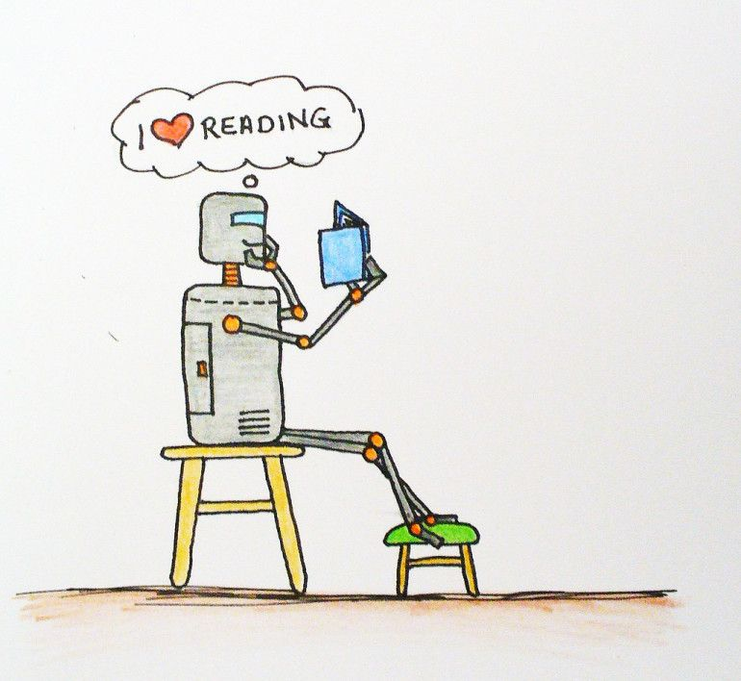
Study guide
8 study themes, i.e. 8 chapters
Study guide describes:
What you must do in each study theme
Which sections in the chapter you must do
Use study guide as guide on what to study!

Slide 13

“Class” rules
Lectures
New work is covered every day.
Pirate code…
We expect professional behaviour and emails.

Slide 14

Week 1: What now?

Slide 15
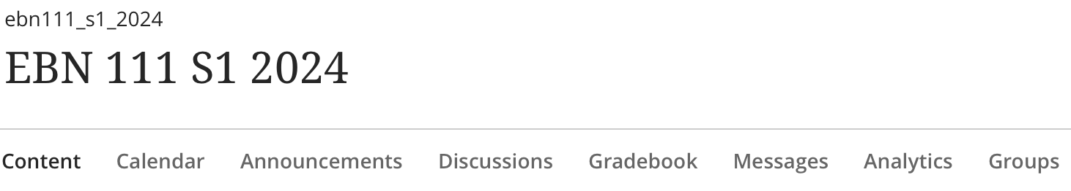
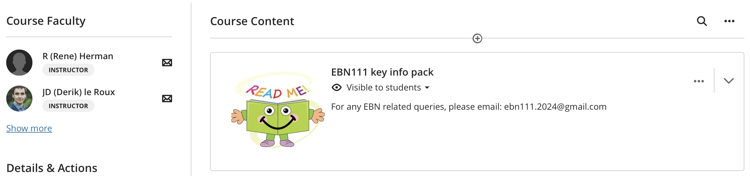
Step 1: Access the EBN111 ClickUP module.

Slide 16
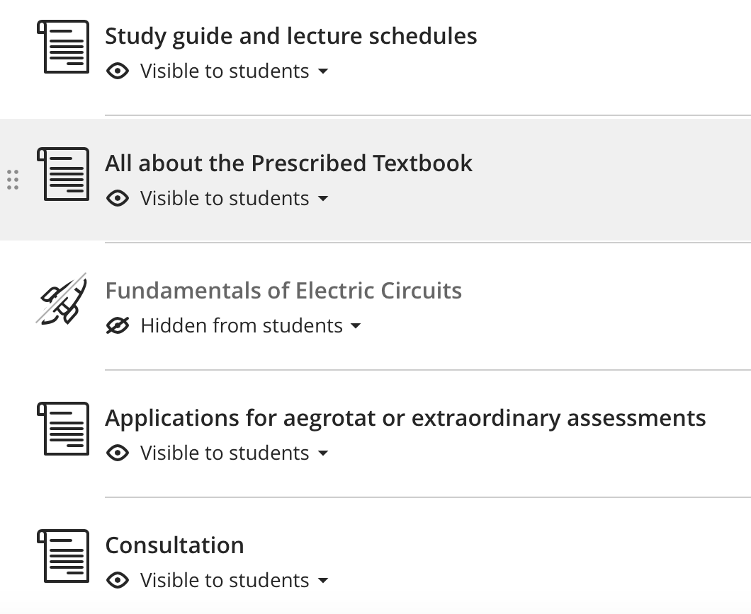

Step 2: Make sure you obtain a copy of the textbook.
Notes:
Remember to READ the textbook!

Slide 17
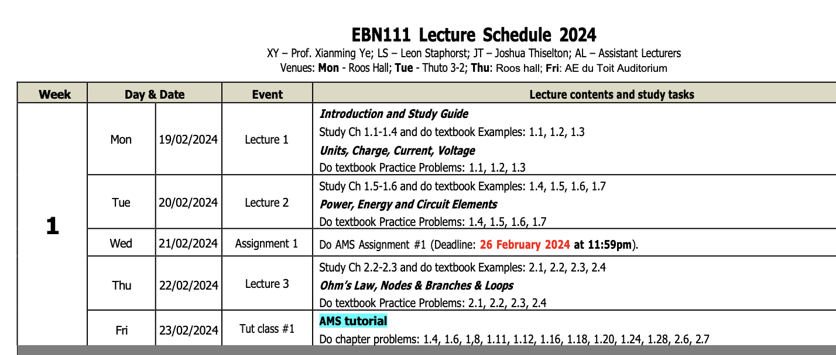
Step 3: Lecture Schedule
Notes:
So that you know what to do and when to do it!

Slide 18
Step 4: Tutorials
Tutorial days
Do questions at the end of the chapter.
If you can’t do a question, post your query on the Discussions Forum.
The memo is released on day of tutorial.
View the memo and watch videos for questions you did not understand.

Slide 19
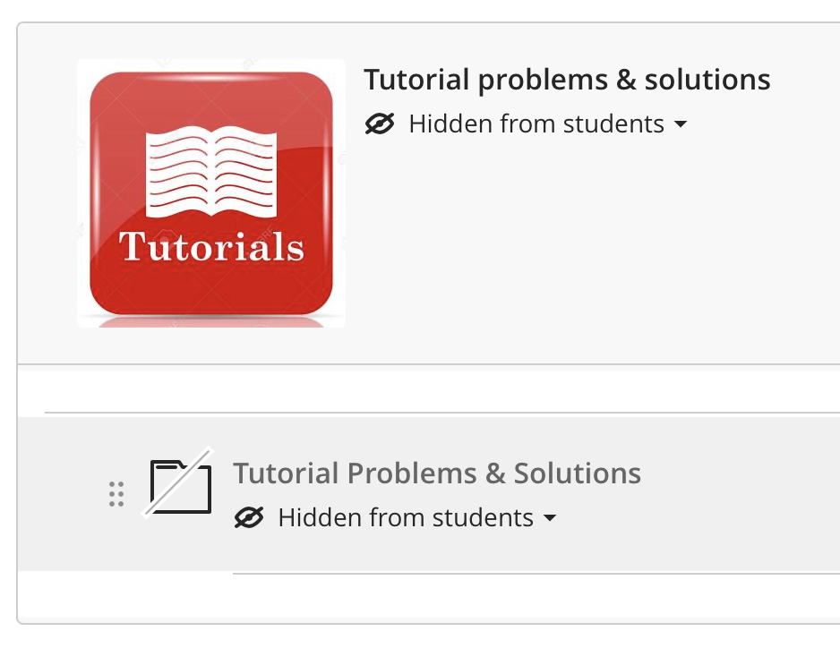
Step 5: Tutorials
Where to find the tutorial problems memos?

Slide 20

Step 6: Assignments
Assignments are done via https://ams.up.ac.za/
Assignments will be released on AMS on Wednesday 20 Feb.

Slide 21
Some tips for communication

Slide 22
Struggling with a topic
“I don’t understand Chapter 1”
Too Vague
“I am struggling with Ohm’s Law”
Still too vague

Slide 23
Email Etiquette
Greet:
Dear Sir/Madam
Dear Mr/Mrs/Dr/Prof
State your problem POLITELY!!!!!
Let us know who you are
Kind regards,
Name: Name Surname
Student No: 12345678

Slide 24
Email Etiquette
Student who submitted a tutorial but their marks didn’t appear on the list.
Email:
I submitted my tutorial but my marks don’t appear on the list!!!!!! Find my tutorial and rectify this mistake or I will take this to a higher authority!!!!! My name is XYZ, please get back to me ASAP!!!!!!!!

Slide 25
Email Etiquette
Example:
Dear Dr. Ye
The marks for tutorial 3 have been published and my marks are not on the list. I did hand in the tutorial so I am not sure why my marks have been omitted. I would appreciate your help with this problem.
Kind Regards,

Slide 26
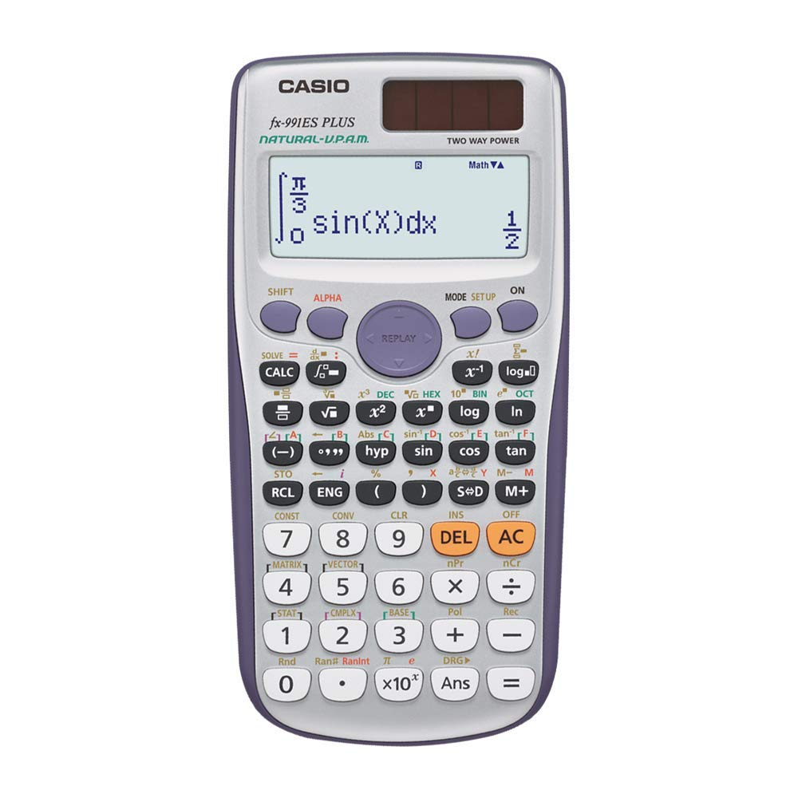
Calculator
Solve simultaneous equations
Complex number
Casio fx-991ES PLUS
No graphing calculators!!!!

Slide 27

ECSA
What is ECSA?
Engineering Council of South Africa
ECSA is in partnership with the State and the engineering profession to promote a high level of education and training of practitioners in the engineering profession so as to facilitate full recognition of professionalism in the engineering profession, both locally and abroad.
What is the purpose of accreditation?
Engineering programmes accredited by ECSA are recognised as meeting the initial academic requirements for registration as a Professional Engineer in South Africa.
International recognition of these programmes is provided through the Washington Accord.
Signatories to the Washington Accord have undertaken to make every reasonable effort to ensure that bodies responsible for Professional Engineers practicing in its country, mutually recognise the substantial academic equivalence of engineering academic programmes accredited by other Accord signatories.

Slide 28
ECSA Graduate Attributes
What are Graduate Attributes(GA’s)?
Each engineering student is assessed according to 10 ECSA GA’s at end of study period
GA 1: Problem Solving
GA 2: Application of scientific and engineering knowledge
GA 3: Engineering Design
GA 4: Investigations, experiments and data analysis
GA 5: Engineering methods, skills and tools, including Information Technology

Slide 29
ECSA Graduate Attributes
What are Graduate Attributes(GA’s)?
Each engineering student is assessed according to 10 ECSA GA’s at end of study period
GA 6: Professional and technical communication
GA 7: Impact of Engineering activity
GA 8: Individual, team and multidisciplinary working
GA 9: Independent learning ability
GA 10: Engineering Professionalism

Slide 30
ECSA Graduate Attributes
Graduate Attributes assessed in EBN111/122:
GA 1: Problem Solving
Demonstrate competence to identify, assess, formulate and solve convergent and divergent engineering problems creatively and innovatively.
GA 2: Application of scientific and engineering knowledge
Demonstrate competence to apply knowledge of mathematics, basic science and engineering sciences from first principles to solve engineering problems.

Slide 31

Questions?

